Slide 1
Small Grants for Enroute Students
By; Ahtziri R Pena and Nayeli Villalobos

Slide 2
What is it?
The En/Route Service-Learning Grant project gives students the opportunity to organize a project benefiting their community partner, and is based on a community need they understand and can adequately address.
The grant was created by Melissa Nix who adapted it from the Peace Corps Grants
Past grant awards have been between $100 and $500.

Slide 3
Annika Belle Wuelpern
Sidney Hutchins
Veronica Martinez, Samantha Scott and McKenna Sweeney
Hannah Fenton
Miya Leonard
Examples of small grants 2018-2019 Class

Slide 4
Hannah Fenton was able to help Earthlinks by aiding in the purchase of a new drill press.
Earthlinks old drill press broke and was so outdated that the manufacturer no longer makes the parts to repair the machine. Replacing this tool was vital because it is used to make several of EarthLink's vital products such as bee boxes and wall vase products.
Hannah F.

Slide 5
Annika Belle Wuelpern provided a grant to Reading partners that helped them to advertise and hire more volunteers.
In order for students to be successful in improving their reading skills, they need dedicated volunteers who can tutor them. One of Reading Partners greatest struggles is having enough volunteers to help students that are in need, and Annika's grant helped to ensure that the program could continue to serve as many kids as possible.
“
Annika W.

Slide 6
Veronica Martinez, Samantha Scott and McKenna Sweeney, working together at Florence Crittenton Services, used a grant of $400 to expand and maintain a large garden plot at the Early Childhood Education Center.
This garden is used to introduce young mothers and their children to the joys of gardening and to provide fresh, healthy food that they helped to grow themselves.
“
Veronica Martinez, Samantha Scott and McKenna Sweeney

Slide 7
Sidney Hutchins applied for and received grant money to purchase children's books for Reading Partners that better reflect and represent the diverse population of students that the program serves.
“
Sidney H.

Slide 8
Miya Leonard, working with the Bridge Project at Quigg Newton, received a grant to provide fresh classroom materials such as whiteboards, dry erase markers and clipboards.
These supplies are essential for engaging students and making them a part of their own learning process, and for continuing the good work of the Bridge Project
“
Sidney H.

Slide 9
Why do we believe in it?
Organizing this project is also an opportunity for deeper collaboration between site supervisors and the students they work with.
This grant application exercise is to prepare students for grant applications outside of the university.
It is a resume starter
You are helping a community further in their goals
Non profit - essential for their organization

Slide 10
Our process is easy: How do you apply?
Brainstorm
Set up a meeting with your supervisor
Fill out application
Wait for a response!

Slide 11
Application
name/ email/ number
Site name
Supervisor name and email
Project Summary
Goals & Needs
Assets of the Community
Objectives
Budget breakdown
https://forms.office.com/Pages/ResponsePage.aspx?id=2cXU7P7CIkWv0fDSB1XZ18IVcE4G4IBLuWCqD2DH425UMUhBREw1VkJXM0YxVkY5VlNQQUQ2STlBTy4u

Slide 12
Application
name/ email/ number: Sidney L sL@regis.edu,, 123-456-7890
Site name: Reading Partners- Trevista at Horace Mann
Supervisor name and email: Julie Keller, jkeller@readingpartners.org
Project Summary: Please write a detailed description of your project that includes whether or not you intend on working in a group, how much the project will cost, and what the grant funding would be used for. (200-300 words)

Slide 13
Project Summary
"I have been at my service site Reading Partners at Trevista Horace Mann since early November of 2018. In that time I have noticed amazing strides in comprehension and literacy among many of my students, but I can’t shake the fact that they are completely under represented in the curriculum they are told to follow. The majority of students enrolled in Trevista, and the Reading Partners program, are minority groups. To my surprise, and maybe yours too, about only one out of the ten books we read to them have non-white characters. This proves to be very concerning for a myriad of reasons, but what I would like to focus on is the issue of alienation in our education system’s curriculum. I would even argue that it is poisonous both to the over represented and underrepresented for different, but equally devastating reasons. Diversity, even when proven to build stronger, better, brighter learning environments has been put on the backburner for decades. I hope that through this grant, and close partnering with Reading Partners, that I can use the 400 dollars to bring more diverse (see my definition of diverse in the budget section) books into the classroom. I think that by giving our students the representation they need and deserve, we will see a more interactive, involved, and reflective response to our tutoring sessions. The entire mission of Reading Partners, to help students become lifelong readers, is a group effort carried out by dedicated tutors and respective supportive staff. Since curriculum is taught and administered to students by multiple different tutors it seems as though this grant project will continue to be a group project for the foreseeable future. The grant funding (approximately 400 dollars) would go towards diverse books (32) being implemented into the classroom. "

Slide 14
Application
name/ email/ number: Sidney L sL@regis.edu,, 123-456-7890
Site name: Reading Partners- Trevista at Horace Mann
Supervisor name and email: Julie Keller, jkeller@readingpartners.org
Project Summary: Please write a detailed description of your project that includes whether or not you intend on working in a group, how much the project will cost, and what the grant funding would be used for. (200-300 words)
Goals & Needs: Please consider the background and needs of the people in the community. What social injustices does your organization try to address? What goals will this project achieve, and how would they benefit your organization and/or the community? In other words, what need(s) will this project meet? (300 word limit)

Slide 15
Goals & Needs:
“Trevista consists of a diverse student population in which 91% of students are minority groups and another 27% are English Language Learners (ELL). Reading Partners does an amazing job of providing structure and one-on-one tutoring services to promote better reading habits to students, but unfortunately lack the resources needed to reflect the diverse community they serve. My project will benefit the RP student population of Trevista by providing students characters they can empathize and identify with while being able to reflect on their own life experiences. We are doing our students a huge disservice by not mirroring what their own life/environment looks like in our curriculum. Ezra Hyland, professor of African American Literature at University of Minnesota, wrote in Students Have a Right and a Need to Read Diverse Books that “When you have children in school and the literature doesn’t look like them, it doesn’t sound like them, it does not deal with their issues, you’re pushing them out rather than inviting them in.” This is a point we can’t dismiss. It is not enough to offer the time and services these students need to catch up in reading-related skills-- we need to build up confidence in who they are in and outside of the classroom. I think that the only way to do this is by doing more than just endorsing diversity, more than just saying it’s a “good” thing. We need to take the steps towards building a stronger, better, brighter learning environment for our students by giving them the characters they know-- the characters that make up their family, their best friend at school, themselves. We need to take priority in making our students feel safe in their bodies, celebrate our cultures, and show them that white kids cannot and will not be the only ones who are made visible.”

Slide 16
Application
name/ email/ number: Sidney L sL@regis.edu,, 123-456-7890
Site name: Reading Partners- Trevista at Horace Mann
Supervisor name and email: Julie Keller, jkeller@readingpartners.org
Project Summary: Please write a detailed description of your project that includes whether or not you intend on working in a group, how much the project will cost, and what the grant funding would be used for. (200-300 words)
Goals & Needs: Please consider the background and needs of the people in the community. What social injustices does your organization try to address? What goals will this project achieve, and how would they benefit your organization and/or the community? In other words, what need(s) will this project meet? (300 word limit)
Assets of the Community: What are some of the assets of the community you are serving and how will this project bring out the strength of its members? What are talents and resources that are already present within the community, and how will you utilize them? (300 word limit)

Slide 17
Assets of the Community
“I would say that the biggest strength within this community can be seen in our incredible site coordinator, Julie Keller, who devotes every resource she can get her hands on to serve her students. It goes without saying that, in addition to Ms. Keller, our incredibly driven tutors who volunteer much of their own time to consistently work with students are a priceless asset to this community. These individuals who I have had the pleasure of working alongside have demonstrated patience, adaptability, and persistence when it comes to their students. I think that by giving us, the tutors, more accurate representation of our students can only increase our capacity to help, to understand, to connect, and to find new ways of teaching. The availability of diverse books in the classroom will allow tutors to more directly help their students by seeing what particular stories they are drawn to, and how they can apply those interests to the overall Reading Partners curriculum. Every session begins with a tutor read aloud where the student chooses a book and the tutor then spends 10-15 minutes reading the book aloud. Most kids start losing attention rather quickly, especially when it’s the same stories with the same characters being shoved at them over and over again. Additionally, every session ends with the option for students to bring books home to build up their personal libraries. These two instances are where I really notice the lack of representation in books made available. Most of the students I have worked with decide against bringing a book home simply because the ones made available to them aren’t interesting, they can’t relate to it. Which then eliminates the crucial reading practice they could be having at home.”

Slide 18
Application
name/ email/ number: Sidney L sL@regis.edu,, 123-456-7890
Site name: Reading Partners- Trevista at Horace Mann
Supervisor name and email: Julie Keller, jkeller@readingpartners.org
Project Summary: Please write a detailed description of your project that includes whether or not you intend on working in a group, how much the project will cost, and what the grant funding would be used for. (200-300 words)
Goals & Needs: Please consider the background and needs of the people in the community. What social injustices does your organization try to address? What goals will this project achieve, and how would they benefit your organization and/or the community? In other words, what need(s) will this project meet? (300 word limit)
Assets of the Community: What are some of the assets of the community you are serving and how will this project bring out the strength of its members? What are talents and resources that are already present within the community, and how will you utilize them? (300 word limit)
Objectives: What are some measurable and attainable objectives of this project? How will you measure and verify its success? (300 word limit)

Slide 19
Objectives
“If implemented, we will clearly be able to see immediate success generated by this project. I say this because one in ten books for the kindergarten students have characters portrayed to them as other than white-- out of 100 books only ten percent of them have non-white characters. If we added the 32 new books into our kindergartener’s reading library, and accounting for one in ten books mentioned earlier, we would get our more diverse representation up to 24.8%. It is not anywhere close to where we need to be, but that 14.8% jump in representation is very necessary to the growth and support of our students. In regards to ELL, we would see a 100% increase (since they aren’t available as of now) in bilingual/Spanish books made available to them and their families. My hopes for this project is to bring awareness to the lack of representation to students broadly, since it is a systemic issue, but for our purposes I would like to see a specific change in this small community that is doing so well in other crucial gaps of our education system. It is also my hope that we can start with this small 14.8% increase to match our incredible diverse range of students, and that we as a community can keep working on this project for years to come. “

Slide 20
Budget Breakdown
“I would use the 400 dollar award to buy new books for Reading Partner’s kindergarten students that specifically lack diversity in their selection of books. I tried to find authors that present themes such as diversity (LGBTQIA, POC, gender diversity, religious minorities, and people with disabilities)* /multiculturalism, diverse family dynamics, mental health/positive mindsets, and bilingual stories (for our ELL students). *including but not limited to I talked to the buyer for Bookies (a local Denver bookstore), but since it is such a small business I wouldn't be able to purchase as many books for my students as if I were to buy from a larger retailer. As a result I found it would be best to order from Amazon for their prices and wide selection of books.”

Slide 21
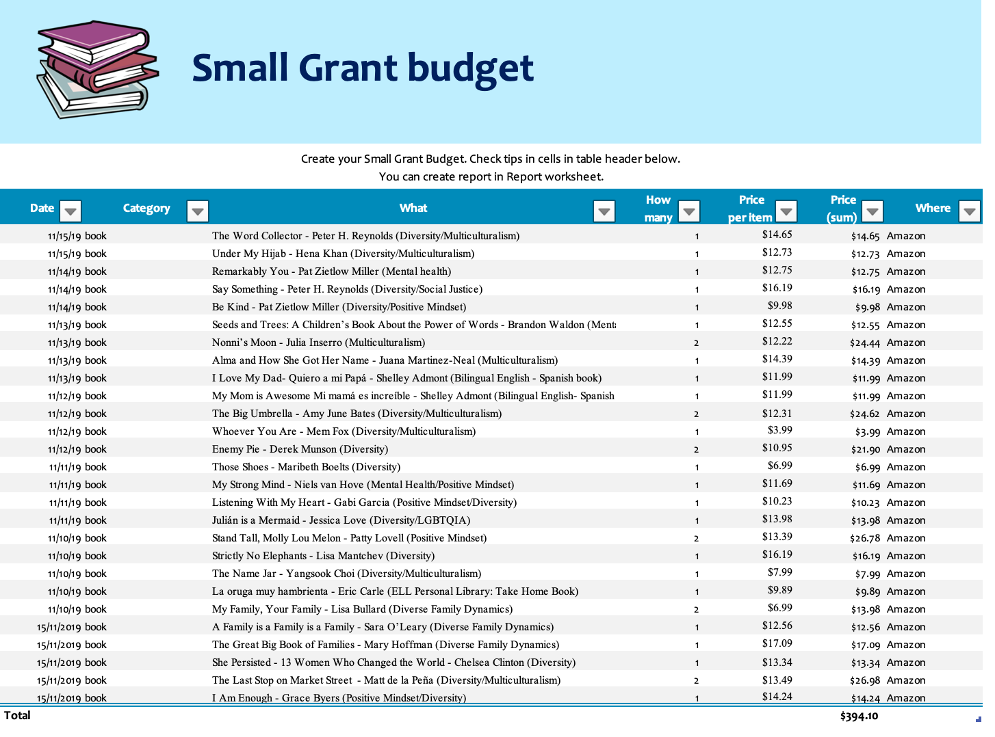

Slide 22
Agenda/ Deadlines
Complete Supervisor Meeting- start writing down what you’re going to be doing with the money, tell ESA, apply!!
Introduction to small grants
December 2019
February 2020
November 2019
January 2020
Let supervisor know you’re interested ( start brainstorming ideas)
Set up a meeting with supervisor next month and have plan laid out
Last month to Apply- Receive notification a week after deadline.
**February 14th deadline **
Notes:
Brainstorm outline due
Meeting with CP due
Plan due
Budget sheets due
Application due
Reflection due

Slide 23
Important Contacts
Ahtziri R Pena
arodriguezpena@regis.edu
Melissa Nix
mnix@regis.edu
Nayeli Villalobos
nvillalobosgarcia@regis.edu
Sammie Scott
sscott009@regis.edu
Regi Woeles
rworles@regis.edu

